Slide 1
SEMINAR SEMINAR ON BUCCAL DRUG DELIVERY SYSTEM

Slide 2
CONTENTS ….
INTRODUCTION
STRUCTURE OF BUCCAL MUCOSA
APPROACHES OF BUCCAL DOSAGE FORM
IDEAL DRUG CANDIDATES
METHODS TO INCREASE DRUG DELIVERY VIA BUCCAL ROUTE
EVALUATIONS
ADVANTAGES
LIMITATIONS
MARKETED PRODUCTS.
REFERENCES
MARKETED PRODUCTS
CONCLUSIONS
REFERENSES

Slide 3
INTRODUCTION
Administration of drug via buccal mucosa (linings of cheek and area between upper and lower lips) to the systemic circulation.
Potential route for typically large, hydrophilic and unstable proteins , oligonucleotides, and poly saccharides.
For local and systemic drug delivery.
Most buccal formulations are designed to provide sustained release of active ingredients.
/

Slide 4
BUCCAL MUCOSA
Within the oral mucosal cavity, delivery of drugs is classified into three categories
(i) sublingual delivery,
(ii) buccal delivery, (iii) local delivery,
Within the oral mucosal cavity, the buccal region offers an attractive route of administration for systemic drug delivery. The mucosa has a rich blood supply and it is relatively permeable.

Slide 5
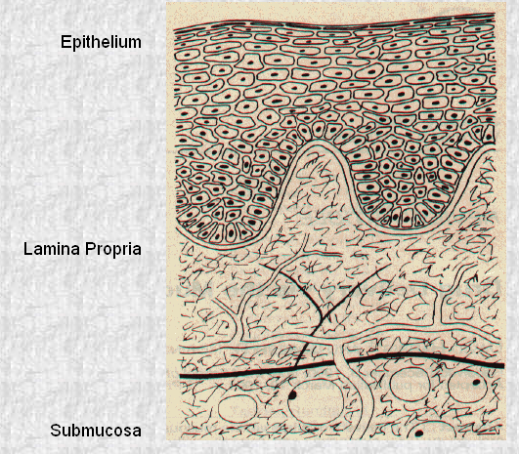
STRUCTURE OF ORAL MUCOSA

Slide 6
The oral mucosa is composed of an outermost layer of stratified squamous epithelium . Below this lies a basement membrane, a lamina propria followed by the submucosa as the innermost layer
A. Buccal Epithelium
The buccal epithelium is composed of 40 to 50 layers of nonkeratinized stratifiedsquamous cells. It is 500 to 800μm in thickness with varying degrees of maturity.
The uppermost superficial layer of cells is comprised of flattened compact differentiatedcells of about 150μm in thickness
PERMEABILITY
oral mucosae is leaky epithelia intermediate between that of epidermis and intestinal mucosa.
permeability is4- 4000 times greater than that of skin.

Slide 7
B. Lamina Propria
The lamina propria consists of collagen fibrils, a supporting layer of connective tissue, blood vessels, and smooth muscle. The structure of the lamina propria is not dense and it is not a barrier to drug permeation
C. Submucosa
The submucosa is a relatively dense connective tissue that contains a few accessory salivary glands,mucus acinus
Mucus acini are surrounded by myoepithelial cells that aid in the secretion of saliva.

Slide 8
Mucosal Environment :
The cells of the oral epithelia are surrounded by an intercellular ground substance, mucus, the principle components of which are complexes made up of proteins and carbohydrates.
The mucus is also believed to play a role in bioadhesion of mucoadhesive drug delivery systems .
the presence of saliva produced by the salivary glands. Saliva is the protective fluid for all tissues of the oral cavity. It protects the soft tissues from abrasion by rough materials and from chemicals.

Slide 9
BUCCAL ROUTE OF DRUG ABSORPTION
There are two permeation pathways for passive drug transport across the oral mucosa: paracellular and transcellular routes.
TRANSCELLULAR PERMEATION
Drug permeation through the epithelial cells involves transport across the apical cell membrane , the intracellular space, and the basolateral membrane.
PARACELLULAR PERMEATION
Drug permeation through the epithelial cells also involves transport through the lipid or in between epithelial cell.

Slide 10
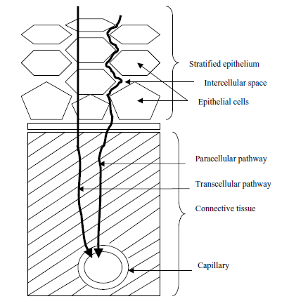

Slide 11
APPROACHES OF BUCCAL DRUG DELIVERY
1) MATRIX TYPE.
-CONVENTIONAL BUCCAL TABLETS.
-NOVEL BUCCAL ADHESIVE TABLETS.
2) RESERVIOUR TYPE.
-BUCCAL PATCHES
3)BUCCAL FILMS.
4) BUCCAL MUCOADHESIVE HYDROGEL.
5) BUCCAL SPRAY.
6)FAST DISSOLVING BUCCAL TABLETS.
7) BUCCAL WAFERS.
8) BUCCAL MICROSPHERE.

Slide 12
DESIGN OF BUCCAL DOSAGE FORM
MATRIX TYPE: 1) CONVENTIONAL BUCCAL TABLETS.
2)NOVEL BUCCAL ADHESIVE TABLETS
Hydrophilic and Hydrophobic matrices have been used.
For moderatly water soluble drugs ,hydrophilic matrices of HPMC
Are widely used to conrol release.
Sodium carboxy methyl cellulose (SCMC), Hydroxy propyl methyl cellulose (HPMC), sodium alginate and guar-gum as mucoadhesive polymers.
The carbopol-934 is used as a primary polymer because of its excellent mucoadhesive property and secondary polymers like HPMC, SCMC, and guar-gum were used.

Slide 13
EX. A polymeric matrix system containing pectin, HPMC ,and diltizem HCL prepared by direct compression .further two external layer are applied.(Geomatrix tri layer tablets,)
-the two external layer control rate of dehydration of core, there by restricting surface area available for diffusion.

Slide 14
Ideal buccal adhesive system :
-maintain it’s position in mouth.
-release the drug in controlled manners.
Provide drug release in unidirection.
Example..mucoadhesive buccal tablet of diltiazem HCL.
Ex.verapamil buccal tablets,sumatriptan succinate buccal tablets.

Slide 15
ii)RESERVIOUR TYPE
Contains cavity for drug and additives separate from adhesive.
Impermiable backing-controls direction ,reduce patch deformation, and disintegration.

Slide 16
BUCCAL ADHESIVE PATCHES.
Buccal adhesive patches are modified release dosage form that have potential to provide controlled drug delivery from 1 to 24 hrs .
They adhere to buccal mucosa for extended period of time.
They consists of solid matrix ( non-dissolvable or slowly dissolvable ).
They may be
-Unidirectionally.
-bidirectionally.
-multidirectionally.

Slide 17
(a) bidirectional release from adhesive patch by dissolution or diffusion;
(b) unidirectional release from patch embedded in an adhesive Shield
(c) bidirectional release from a laminated patch;
(d) unidirectional release from a laminated patch.

Slide 18
Adhesive polymer itself act as drug carrier or adhesive layer link between drug loaded layer and mucosa.
Size-generally 1-16 cm2
But 1-3 cm2 used .
Large sized patches are placed at central position of buccal mucosa.
. Two methods used to prepare adhesive patches include solvent casting and direct milling . In the solvent casting method , the intermediate sheet from which patches are punched is prepared by casting the solution of the drug and polymer onto a backing layer sheet and subsequently allowing the solvent to evaporate

Slide 19
Three basic type of bucccal patches to achieve targeted drug release.
i) monolithic matrix( for multidirection release)
ii) a multilayer matrix ( having semi permeable backing layer)
iii) multilayer matrix (having impermeable layer over back and side of device)
E. g. 1) MUCO ADHESIVE BUCCAL PATCHES CONTAINING VERAPAMIL HCL.
2) BUCO ADHESIVE BUCCAL PATCHES OF CARVEDILOL
B uccal patches prepared from chitosan with pvk-30
Also from HPMC , CARBOPOL . EUDRAGIT-RS100

Slide 20
BUCCAL FILMS.
Thin film drug delivery has emerged as an advanced alternative to the traditional dosage form .
placing the strip on or under the tongue or along the inside of the cheek.
As the strip dissolves, the drug can enter the blood stream , buccally or sublingually.
Buccal mucosa preferred over sub lingual mucosa.

Slide 21
It consists of
film forming polymer .
Plasticizer.
API
Stabilizing and thickning agents.
E.g.buccal film of salbutamol.
BUCCAL FILM
MARKETED PRODUCT: ONSOLIS (FANTANYL BUCCAL SOLUBLE FILM)
WHICH IS USED IN MANAGEMENT OF SEVERE PAIN OF CANCER.

Slide 22
MUCOADHESIVE HYDROGEL
These are hydrophilic matrices that are capable of swelling when placed in aqueous media.
Hydrogels, which release the drug by swelling and thereby allowing drug transport through the spaces in the polymer network, are being widelystudied for their use in bioadhesive gels. Polyacrylic-based hydrogels have alsobeen extensively studied. An example of a commercially available device is theOTS (oral transmucosal system, TheraTech), which has been used to deliver glucagon-like insulintropic peptide.
Example.chitosan glutamate buccal hydrogel with local anaesthetics activity.

Slide 23
MUCOADHESIVE HYDROGEL mainly used for local action.
Various polymers are used to prepared mucoadhesive hydrogel such as chitosan and its derivatives.
To obtain mucoadhesive hydrogel , two properties have to be optimised.
1)polarity of polymer surface.
2)molecular mobility of polymer.

Slide 24
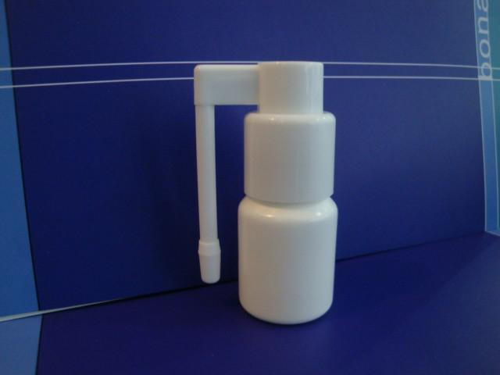
BUCCAL SPRAYS.
GENEREX BIO TECHNOLOGY have introduced insulin spray .which is used for type -1 diabetes patients.

Slide 25
Generex Biotechnology has completed a proof-of-concept study on buccal delivery of heparin using their oral spray platform technology,
This technology is being used to develop a formulation for buccal delivery of insulin for the treatment of diabetes
Buccal spray delivers a mist of fine droplets onto mucosal membrane probably onto mucin layer.
The solvent either is absorbed through membrane or it is diluted by saliva.
The drug substance that in solvent and not immediately absorbed is diposited as athin film onto mucin layer.
E.g.estradiol spray.

Slide 26
Mucoadhesive poymers.
Mucoadhesion is defined as the ability of material adheres to biological tissue for an extended period of time.
Ideal Characteristics of a Buccal Adhesive Polymer
Polymer and its degradation products should be non-toxic, non-irritant and free from leachable impuri-ties.
Should have good spreadability, wetting, swelling and solubility and biodegradability properties.
pH should be biocompatible and should possess good viscoelastic properties.
Should adhere quickly to buccal mucosa and should possess sufficient mechanical strength.
Should possess peel, tensile and shear strengths at the bioadhesive range.

Slide 27
Polymer shoud have following features.
-suitable surface property for wetting mucus/mucosal tissue.
-sufficient flexiblity.
-predominantly anionic hydrophobicity with hydrogen bond forming groups
Factors to be considerations.
- charge of polymers
-molecular wt.

Slide 28
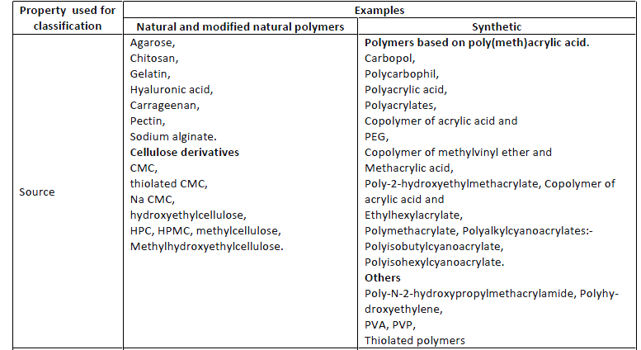

Slide 29
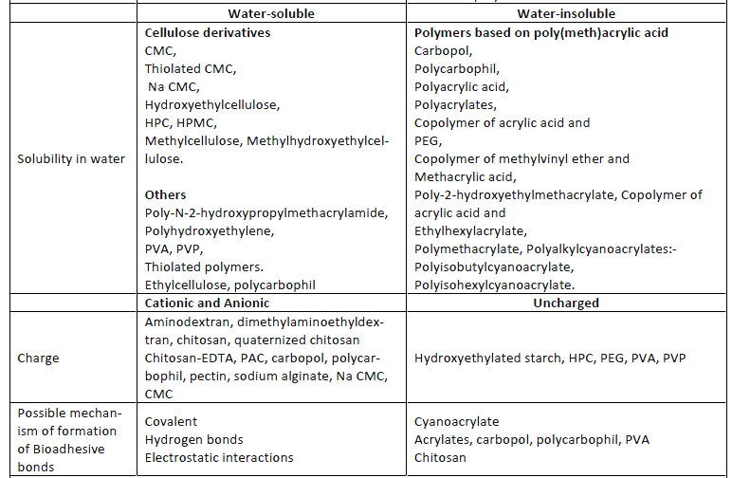

Slide 30
Fast Dissolving buccal Tablets.
Fast dissolving buccal tablets for administring a medicament
includes active ingredients, a lubricunt and water soluble sugar Such as sorbitol,combined such that buccal tablets dissolves in about one minute.
It includes.
-buccally absorbable active ingredients -a lubricant (mg stearate,sds)
-soluble,directly compressible excipients(spray dried sorbitol)
such rapid delivery is useful for delivering a bolus dose to achieve a rapid rise in blood level.
This is covered by patent( U S patent no-5,073,374)

Slide 31
BUCCAL WAFERS: Buccal wafers are rapidly dissolving oral film.
-ORA-VESCENT :This drug delivery system have been designed to promote drug absorption through oral mucosa(buccal)
This may enable more rapid absorption of drug that have a long Tmax.
In case where the patient is vomiting frequently. Or in migraine gastric transit may be so severely compromised. In such circumtance this delivery may be advantageous.
However this technology is protected by patent.
Mechanism by means of CO2 release.
EX. An ORA-VESCENT fentanyl buccal tablet.

Slide 32
BUCCAL MICROSPHERE
. Bioadhesive microspheres offer unique carrier system for many pharmaceuticals and can be tailored to adhere to any mucosal tissue, The bioadhesive microspheres can be used not only for controlled release but also for targeted delivery of the drugs to specific sites in body.
Recent advances , development of polymeric drug delivery systems for protein/peptide drugs .
Bioadhesive microspheres exhibit a prolonged residence time at site of application or absorption and facilitate an intimate contact with underlying absorption surface and thus contribute to improved and/or better therapeutic performance of drugs
E.g. Bio adhesive polymer grafted starch microsphere bearing isosorbide dinitrite for buccal delivery.(chemical abstracts)

Slide 33
BUCCAL COVERED TABLET SYSTEM (BCTS) :
This method restric disintegration from the sides of tablets.
The method involve sandwiching a slowly disintegration buccal mucoadhesive plain tablet between two poly ethylene sheets.
The upper sheets contained a hole that allowed tablet to absorb water and disintegrate only through hole.
The lower sheet contained adhesive to allow the delivery system to adhere to gingiva for a long time.
LIQUID CRYSTALLINE PHASES OF GLYCERYL MONO-OLEATE AS BDDS FOR PEPTIDE AND PROTEIN
-lyotrophic LCP –cobic,lamellar,reversed micellar,hexagonal phase.
-cubic type LCP have ability to incorporate various size of both hydrophilic and hydrophobic drugs.

Slide 34
several innovative self-actuated drug delivery devices designed for administration of drugs to the tissue of the intraoral cavity and the buccal mucosa are being developed including
aerosol sprays,
liquid pump sprays,
Activated mists (i.e., RapidMist™ device),
needleless injectors (i.e., PowderJect® device).
These devices are being developed in multidose formats for a variety of dugs requiring control of
diabetes (i.e., insulin),
pain (e.g., fentanyl and morphine),
anticoagulants (i.e., heparin),
flu vaccines (i.e., influenza) delivered noninvasively to the oral cavity for buccal absorption.

Slide 35
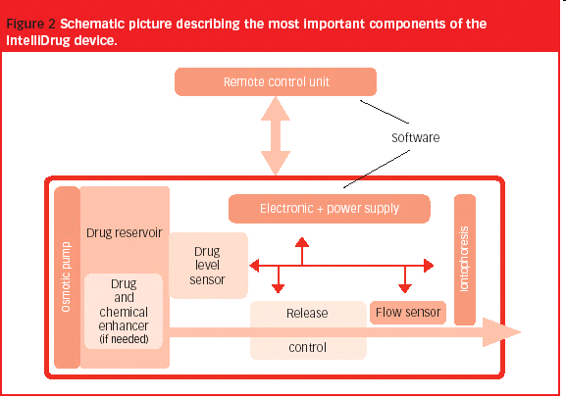
The IntelliDrug device
The 'IntelliDrug' device represents a revolutionary method for delivering drugs for long-term chronic diseases through the buccal mucosa, according to the patient needs, in periods lasting days, weeks or months.

Slide 36
IDEAL DRUG CANDIDATES.
Organic nitrites. (glyceryl tri nitrites )
NASAIDS. (Diclofenac sodium )
Local anaesthetics.
Bronchodilators. (salbutamol)
Antibiotics.
Anti-Diabetes (insulin)
Hormonal products (estradiols)

Slide 37
Methods to increase buccal drug delivery
(1)permeation enhancers,
(2) enzyme inhibitors,
(3) vehicles/cosolvents.
1) Chemical method:
Modulation of drug permeation through the oral mucosa is usually achieved by using chemical penetration enhancers
Bile salts
Bile salts belong to a class of natural or semi-synthetic surfactants and include sodium glycodeoxycholate, sodium glycocholate, sodium taurodeoxycholate, and sodium taurocholate.

Slide 38
Bile Salts
Sodium taurocholate
Sodium taurodeoxycholate
Sodium deoxycholate
Sodium glycocholate and EDTA
Sodium glycodeoxycholate
Sodium glycocholate
Surfactants
Sodium lauryl sulfate
Sucrose laurate
Fatty Acids
Sodium laurate
Sodium myristate
Oleic acid
Lauric acid and propylene glycol

Slide 39
Vehicles and Adjuvants
Ethanol
Propylene glycol
Chelators
EDTA (ethylene diamine
tetraacetic acid)
Salicylates
Sodium citrate
Cyclodextrins
α ,β ,γ cyclodextrins
Methylated β -cyclodextrins
Hydroxypropyl cyclodextrin

Slide 40
They act by
-Changing mucus rheology -Increasing the fluidity of lipid bilayer membrane
-Acting on the components at tight junctions
-By overcoming the enzymatic barrier
-Increasing the thermodynamic activity of drugs
Enzyme Inhibitors
Peptidase inhibitors can be used alone or in combination with permeation enhancers to stabilize peptide and protein drugs to overcome both enzymatic and physicochemical barriers to permeation. Protease inhibitors such as aprotinin, bestatin, and bile salts have been shown to stabilize peptides against buccal mucosal enzymes

Slide 41
Patch design
-drug release profile can be changed.
-single layer and multi-layer patch
Pro drug
-in case of opioid drugs.shows low bio- availability
PH
PH affects permeation of drug. Ex.acyclovir (3.3-8.8 )

Slide 42
Evaluations
A. In Vitro Mucosal Permeation Techniques
The most commonly used in vitro method to study oral mucosal permeability is the use of a permeability chamber . Two types of permeability cells have been used: side-by-side horizontal (i.e., Ussing-type) and vertical (i.e., Franztype).
Diffusion cells are very useful to measure the transmembrane flux of a substance across a mucosa and to study the effects of absorption enhancers on the membrane.
well-defined area of mucosa from an animal is clamped between the donor and receiver compartments of each cell. A known concentration of penetrant can be introduced into one cell (donor) and its concentration measured as a function of time in the other cell (receiver).

Slide 43
Animal Models for Permeability Measurement
The most commonly used animal models are dogs, rabbits, and pigs.
A general criterion for selecting an in vivo animal model is the resemblance of the animal mucosa to the oral mucosa of human beings in both ultrastructure and enzyme activity, which represent the physical and metabolic barriers of theoral mucosa.
Porcine buccal mucosa and rabbit buccal mucosa are mostly used.

Slide 44
EVALUATION OF BUCCAL PATCHES :
Thickness and weight uniformity.
Surface PH study.
Content uniformity.
Folding endurance.
Swelling % study.
Tensile strength.
In vitro residence time.
Muco adhesive strength.
In vitro release study.
Drug release kinetic study.
DSC

Slide 45
IN VITRO ASSESMENT OF MUCOADHESION.
I) Method based on mesurement of adhesion stregth.
-force required to break adhesive bond between model membrane and test adhesive.
ii) method based on mesurement of shear strength.
-measures force that causes bio adhesive to slide with respect mucus layer in a direction parallel to their plane of contact.
iii) Bio adhesion test using non biological substances
-force for separation mesured as quantitative expression.

Slide 46
iv) Florescent probe method.
-this method used to study polymer intraction with a conjunctival epithelial cell membrane.
V) In Situ Method
method to test the bioadhesive potential of polymers. In this technique, glas ,spheres or drug crystals were first coated with the polymer to be tested. Later, known amounts of these coated particles were placed on rat jejunum or stomach
The percent of particles retained on the tissue was considered as an index of bioadhesion.

Slide 47
VI) Organ Culture Technique
. In their study, an organ culture was used to maintain hamster cheek pouch mucosa, submerged on stainless steel grids in a growth medium. Small quantities of adhesive gels were syringed onto the mucosal surface. The duration of adhesion was assessed by retention to the gel.
VII) Ligand Receptor Binding Method
methods that determine lectin receptors presenting on the oral mucosal surfaces can be utilized to assess lectin mucoadhesive property. the binding of lectin to mucosal surfaces by using a solution containing a range of lectins exposed to the surface of unprocessed oral mucosal cells .

Slide 48
VIII) Flow Channel Methods
Flow channel methods utilize a thin channel filled with bovine submaxillary mucin. A particle of a bioadhesive polymer was placed on the mucin gel, and its static and dynamic behavior monitored .
IX)Falling Liquid Film Method
Small intestinal segments from the rat were placed at an inclination on a tygon tube flute. The adhesion of particles to this surface was monitored by passing a particle suspension over this surface .
X) Colloidal Gold Staining Method
This technique utilizes red colloidal gold particles that have been stabilized by an adsorbed mucin molecule (mucin gold conjugate).

Slide 49
Bioadhesive hydrogels develop a red color on the surface upon interaction with the mucus.
XI) Thumb Test
A simple way that can be used to identify mucoadhesives is the difficulty of pulling the thumb from the adhesive and as a function of pressure and contact time
XII) Viscometric Method
Viscosity of a porcine gastric mucin dispersion was measured in different polymer solutions. The mucin polymer bioadhesive bond strength was quantified and the force of adhesion calculated

Slide 50
PRODUCT SAFETY
The usual systemic safety issues for components of a buccal drug delivery system must be considered. However, main the issue is of local irritation.
Many buccal delivery systems contain penetration enhancers which when left in intimate contact with oral cavity tissue for an extended period lead to irritation of the tissue and discomfort to the patient.
E.g.sodium dodecyle sulphate causes irri
On this basis, local irritation and patient acceptance should be addressed very early in the development process.

Slide 51
ADVANTAGES OF BUCCAL DRUG DELIVERY
Ease of administration.
Termination of theraphy is easy.
Permits localization of drug to the oral cavity for a prolonged period of time.
Can be administered to unconscious patients.
Offers an excellent route, for the systemic delivery of drugs with high first pass metabolism, thereby offering a greater bioavailability.
A significant reduction in dose can be achieved there by reducing dose related side effects.
Drugs which are unstable in the acidic environ-ment are destroyed by enzymatic or alkaline envi-ronment of intestine can be administered by this route.
Drugs which show poor bioavailability via the oral route can be administered conveniently.

Slide 52
• It offers a passive system of drug absorption and does not require any activation.
• The presence of saliva ensures relatively large amount of water for drug dissolution unlike in case of rectal and transdermal routes.
• Systemic absorption is rapid.
• This route provides an alternative for the adminis-tration of various hormones, narcotic analgesic, steroids, enzymes, cardiovascular agents etc.
• The buccal mucosa is highly perfused with blood vessels and offers a greater permeability than the skin.

Slide 53
LIMITATIONS OF BUCCAL DRUG DELIVERY
Drugs, which irritate the oral mucosa, have a bitter or unpleasant taste, odour, cannot be adminis-tered by this route.
Drugs, which are unstable at buccal pH cannot be administered by this route.
Only drugs with small dose requirements can be administered.
Drugs may swallow with saliva and loses the ad-vantages of buccal route.
Only those drugs, which are absorbed by passive diffusion, can be administered by this route.
Eating and drinking may become restricted.
Swallowing of the formulation by the patient may be possible.
Over hydration may lead to the formation of slip-pery surface and structural integrity of the formu-lation may get disrupted by the swelling and hy-dration of the bioadhesive polymers.

Slide 54
Marketed products
Striant®, developed by Columbia Labs, is a testosterone extended-release buccal tablet that delivers testosterone systemically for hormone replacement in hypogonadal men.
Asftach® is a buccal tablet containing triamcinolone acetonide for treatment of apththous ulcers, and contains a bioadhesive layer and a dissolvable lactose nonadhesive backing layer
DentiPatch® has been developed by Noven, which is a lidocaine extended-release buccal patch that adheres to the gingival tissue to provide for local analgesia, and was approved in the United States in May 1996.

Slide 55
Cydot® is an example of a patch technology where the patch adheres to the buccal mucosa for a period of up to 24 hours to slowly release melatonin for normalizing circadian rhythms.
Buccal Methyltestosterone
Brand name-Metandren, Ciba;
Avoids first-pass hepatic metabolism
Prochlorperazine
Brand name -Oreton ,Schering Buccastem,
Alternative to enteral tablet

Slide 56
Lists of drug delivered via buccal route
-acyclovir
-carbamazapine
-buprenorpine
-chlorpromazine
-danazol
-diclofenac sodium
-diltiazem
-metronidazole
-nifidipine

Slide 57
Melatonin
Nicotine
Omeprazole
Pentazosine
Propranalol
Pindolol
Morphine sulphate
Ergometrine tartrate

Slide 58
CONCLUSIONS..
Due to success and advantages of drug delivery through oral mucosal tissue, for some drug .there is renewed intrest and active product development activity for next generation of oral mucosal delivery system.
The buccal mucosa offers several advantages for controlled drug delivery for extended period of time.and also promising area for systemic delivery of orally insufficient drugs.and atractive alternative for non-invasive delivery of potent peptide and protein drug molecule.

Slide 59
Research articles
Formulation and evaluation of muco adhesive tablet of timolol maleate.
Formulation and in vitro evaluation of mucoadhesive buccal tablets of diltiazem.
Study of various polymers in buccal drug delivery system.
Transbuccal delivery of chlorpheniramine maleate from mucoadhesive buccal patches.
Development of mucoadhesive film of buccal administration of flufenamic acid.
Mucoadhesive film of losarton potasium for buccal delivery.

Slide 60
DESIGN OF BUCCAL DRUG DELIVERY SYSTEM FOR A POORLY SOLUBLE DRUG
(Asian Journal of Pharmaceutical and Clinical Research Vol.2 Issue 3, July-September 2009 )
A Comparison of In Vitro and In Vivo Drug Release From a Novel Buccal Hydrogel Controlled Release Delivery System.
Bioadhesive Microspheres: A review

Slide 61
Referenses
1) Development of mucoadhesive film for buccal adminitration of flufenamic acid.ijps volume -7,july-2010
2) Drug delivery to oral cavity, molecules to market,by Tapash. K.Ghosh .William.R.Pfister ,
2005
3)mucoadhesive film of losarton potasium for buccal delivery. Ijper ,volume-44(4) ,oct-dec-2010
4) Trans dermal delivery of chlrpheniramine maleate from muco adhesive buccal patches.
5) Smart jd .buccal drug delivery, expert opinion drug delivery. May 2005.

Slide 62
6) Bhaskara Jasti, Xiaoling Li, Gary Cleary, Recent Advances in Mucoadhesive Drug Delivery Systems, Bussiness Briefing : Pharmtech, 2004, 194-196
7) Pramodkumar T.M., Shivakumar H.G., Desai K.G., Oral Transmucosal Drug Delivery Systems, Indian Drugs, 2004, 41(2).
8) Punitha .S , Girish .Y ,Polymer in mucoadhesive drug delivery system- A review, Int. J. Res. Pharm. Sci. Vol-1, Issue-2, 170-186, 2010
9) Lalla J.K. and Gurnancy R.A., Polymers for mucosal Delivery-Swelling and Mucoadhesive Evaluation, Indian Drugs, 2002, 39(5).
10) Michael J .Rathbone and Michael S. Roberts , Modified Release Drug Delivery Technology,volume-126

Slide 63
Design and characterization of mucoadhesive buccal patches containing cetylpyridinium chloride.
(Acta Pharm. 53 (2003) 199–212)
Polymers in mucoadhesive buccal drug delivery system – A review
(Punitha S et al. | Int. J. Res. Pharm. Sci. Vol-1, Issue-2, 170-186, 2010)
Formulation and in vitro evaluation of mucoadhesive buccal tablets of Timolol maleate(Int J Pharm Biomed Res 2010, 1(4), 129-134)
International journal of pharmaceutics, Mucoadhesive Drug Delivery System; Sep 2003,Pg no-175. 2. International journal of pharmaceutics, Mucoadhesive Drug Delivery System; March 2009,Pg no-208.

